Slide 1

Customer Lead Prediction

Slide 2
Key Steps in this Analysis
Dataset Understanding
Data Cleaning
Exploratory Data Analysis (EDA)
Visualization
Insights & Recommendations

Slide 3
Data Cleaning Process
Objective: Ensure data completeness and consistency for analysis. Steps Taken: 1. Analysed Missing Data: Used Excel’s ‘COUNTBLANK’ formula to identify columns with missing values. Assessed the extent of missing data across key variables. 2. Filling Missing Values: Numerical Fields: Used the Median to avoid skewing the data with extreme values. Non-Recoverable Data: Labelled missing values that couldn’t be filled logically with “N/A” to signify unavailable data.

Slide 4
EDA and Visualization
EDA: Analysed lead distribution across fields like “Lead Source” and broke down conversion rates by factors such as “Tags” and “Lead Quality.” Explored how variables like “Total Visits” and “Page Views Per Visit” influence conversion. Visualization: Created funnel charts to track lead progression, bar charts to compare conversion rates by attributes like “Lead Source” and “Tags,” and visualized customer behaviour metrics to understand their impact on conversions. Segmented data by geography and profiles for further insights.

Slide 5
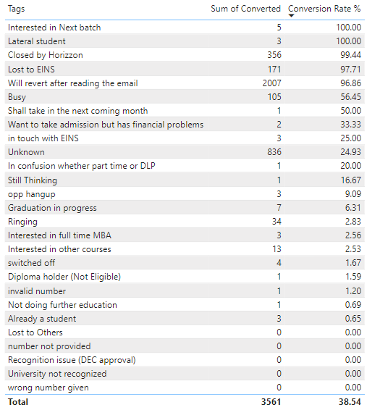
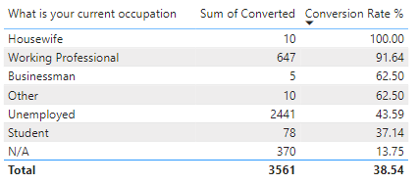
Lead Conversion by Tags and Occupation
Tags like "Interested in Next Batch" and “Lateral student" have high conversion rates (near 100%), indicating strong interest.
Low-performing tags like "Busy" (56.45%) and "Unknown" (24.93%) may require targeted follow-ups.
Occupations such as Housewives (100%) and Working Professionals (91.64%) convert well, while Students (37.14%) and unknown occupations struggle.

Slide 6
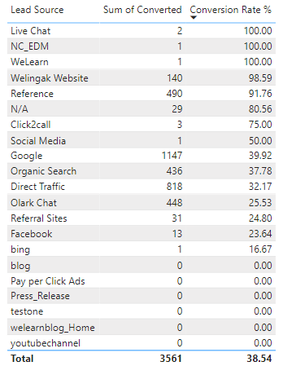
Lead Source Performance:
Live Chat, NC_EDM, and WeLearn have excellent conversion rates (100%).
Google (39.92%) and Facebook (23.64%) have lower conversion rates, signaling potential issues with traffic quality or engagement.

Slide 7
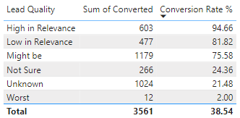
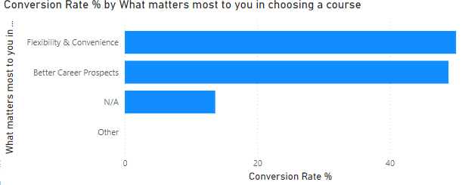
Customer Preferences and Lead Quality
Leads focused on Flexibility & Convenience and Career Prospects have high conversion rates.
High-quality leads (labeled "High in Relevance") perform well, while "Unknown" lead quality converts poorly (21.48%).

Slide 8
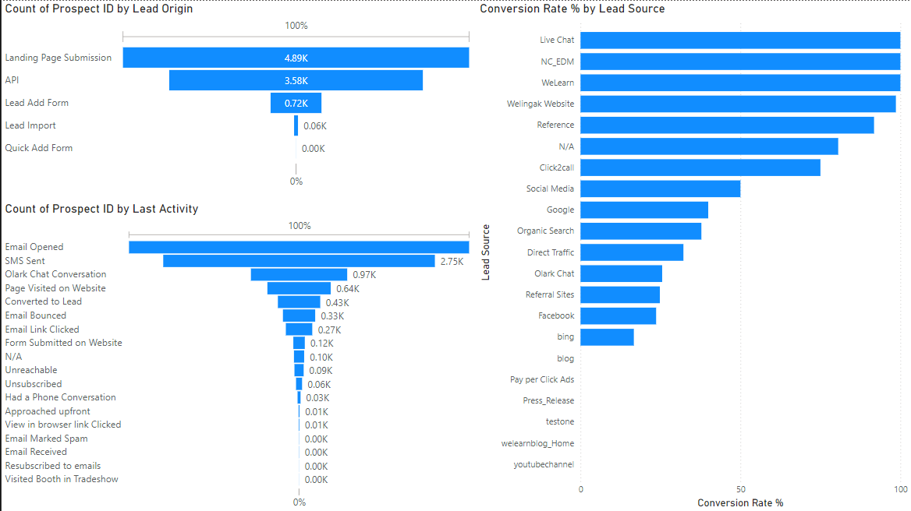
Customer Interaction by Activity
Activities like Email Opened and SMS Sent drive high engagement and conversions.
Lower-performing activities, such as Olark Chat Conversations and Page Visits, suggest the need for better interaction design or follow-up strategies.

Slide 9
Recommendations:
Prioritize follow-ups with undecided or low-converting leads.
Optimize lead sources with lower conversion rates, especially Google and Facebook.
Focus on high-relevance leads and improve engagement for low-performing activities like Chat and Website Visits.
Tailor messaging based on customer preferences around Flexibility and Career Prospects to boost conversions.

